Slide 1


ADMIS Lab
先进数据与机器智能系统实验室
Relational Model
Chapter 2
Yichao Zhang
Email: Yichao Zhang@tongji.edu.cn
Department of Computer Science and Technology
Tongji University

Slide 2
Outline
Structure of Relational Database
Database Schema
Keys
Schema Diagrams
Relational Query Languages
Relational Algebra

Slide 3
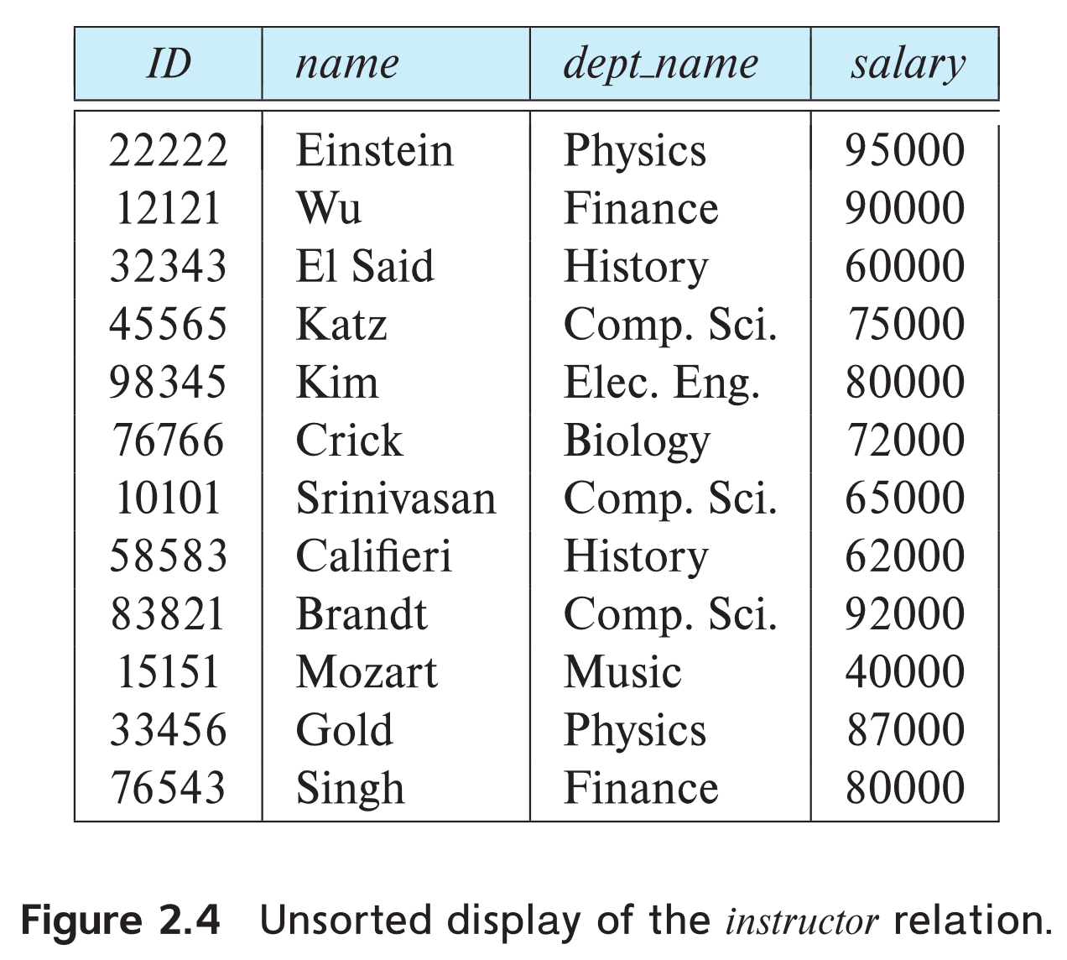
Example of a Relation/Table
Instructor

Slide 4
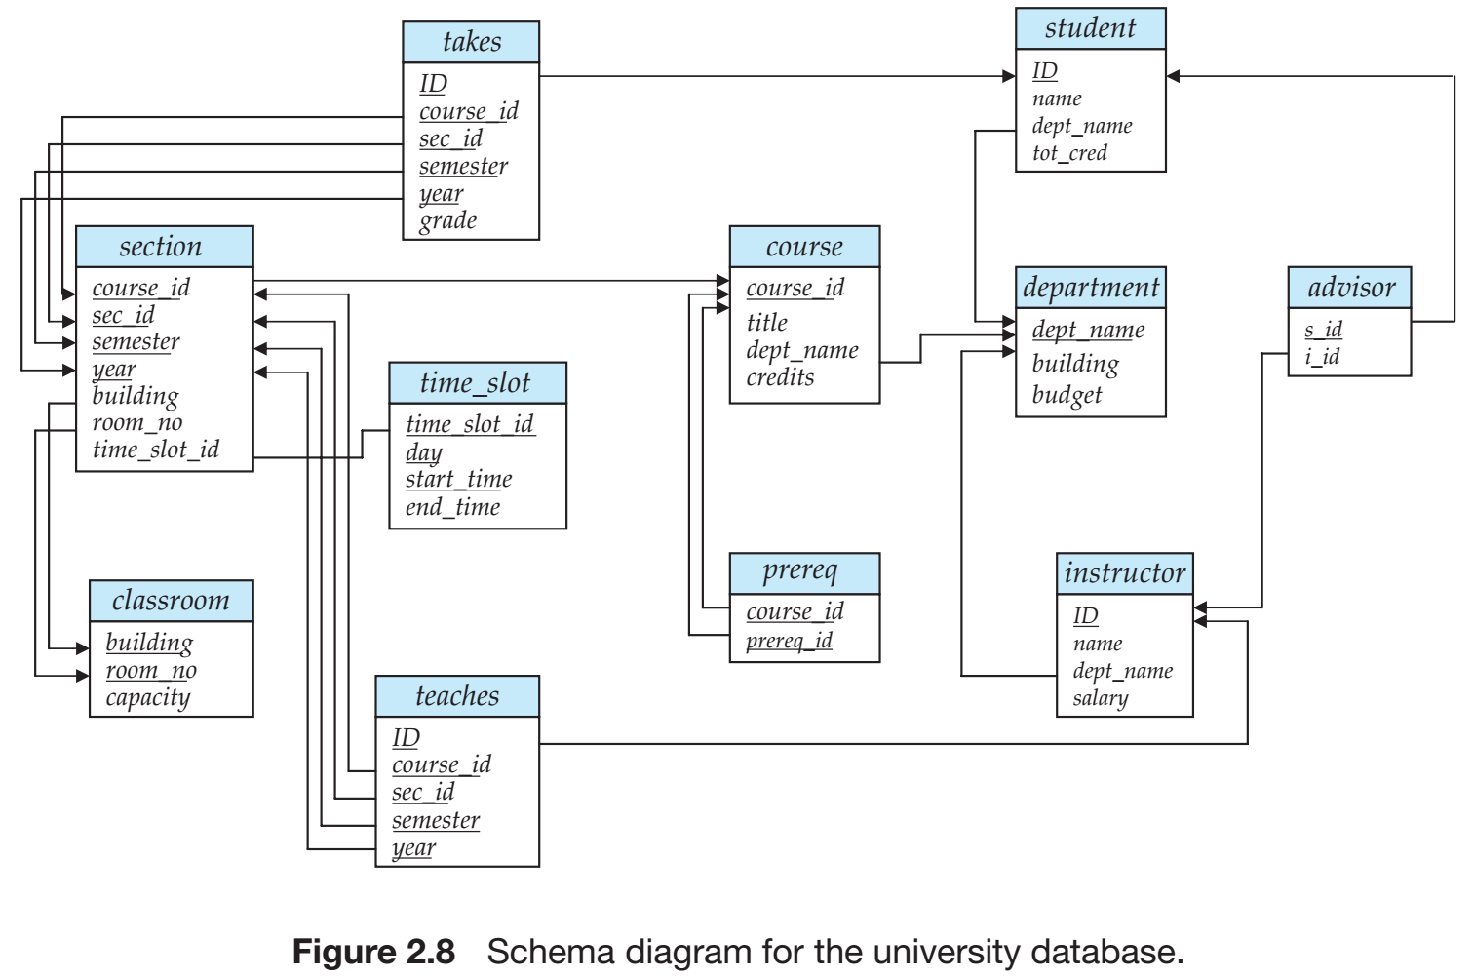
A Sample for Relational Database
University DB

Slide 5
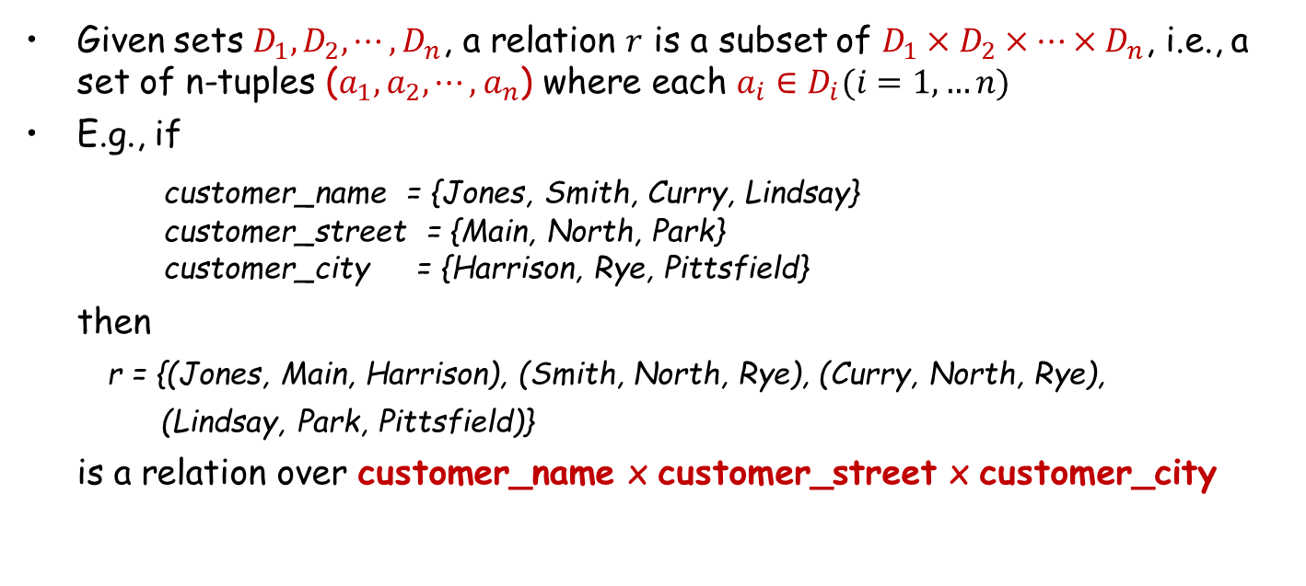
Basic Structure of a Relation
Given sets $D_{1},D_{2},⋯,D_{n}$, a relation $r$ is a subset of $D_{1}×D_{2}×⋯×D_{n}$, i.e., a set of n-tuples ($a_{1},a_{2},⋯,a_{n}$) where each $a_{i}∈D_{i}(i=1,…n)$
E.g., if
customer_name = {Jones, Smith, Curry, Lindsay}
customer_street = {Main, North, Park}
customer_city = {Harrison, Rye, Pittsfield}
then
r = {(Jones, Main, Harrison), (Smith, North, Rye), (Curry, North, Rye),
(Lindsay, Park, Pittsfield)}
is a relation over customer_name x customer_street x customer_city

Slide 6
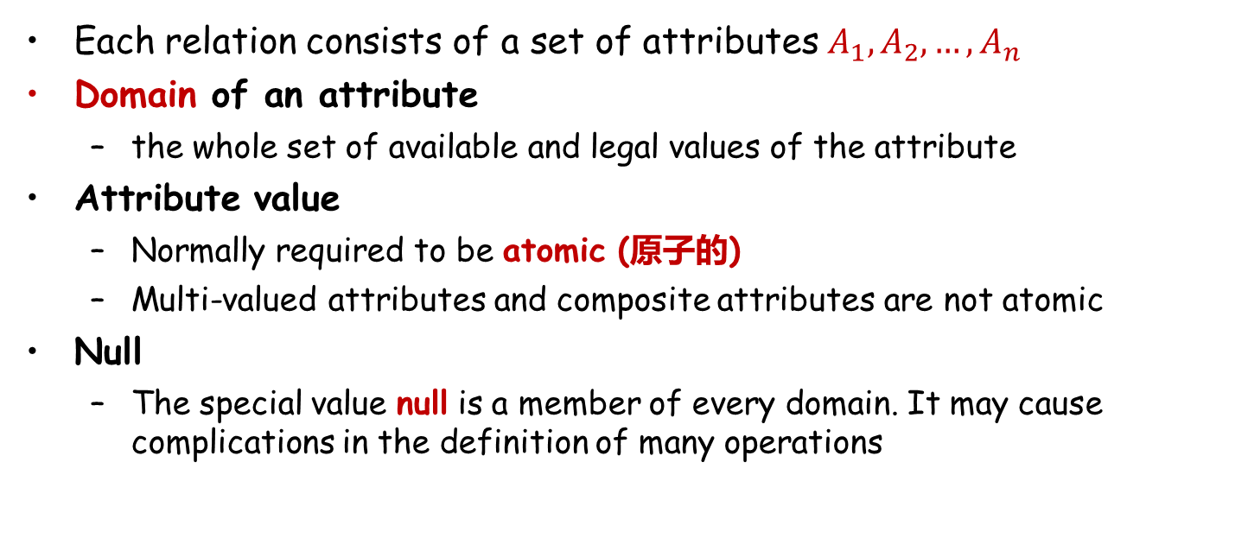
Attribute(属性)
Each relation consists of a set of attributes $A_{1},A_{2},…,A_{n}$
Domain of an attribute
  the whole set of available and legal values of the attribute
Attribute value
  Normally required to be atomic (原子的)
  Multi-valued attributes and composite attributes are not atomic
Null
  The special value null is a member of every domain. It may cause complications in the definition of many operations

Slide 7
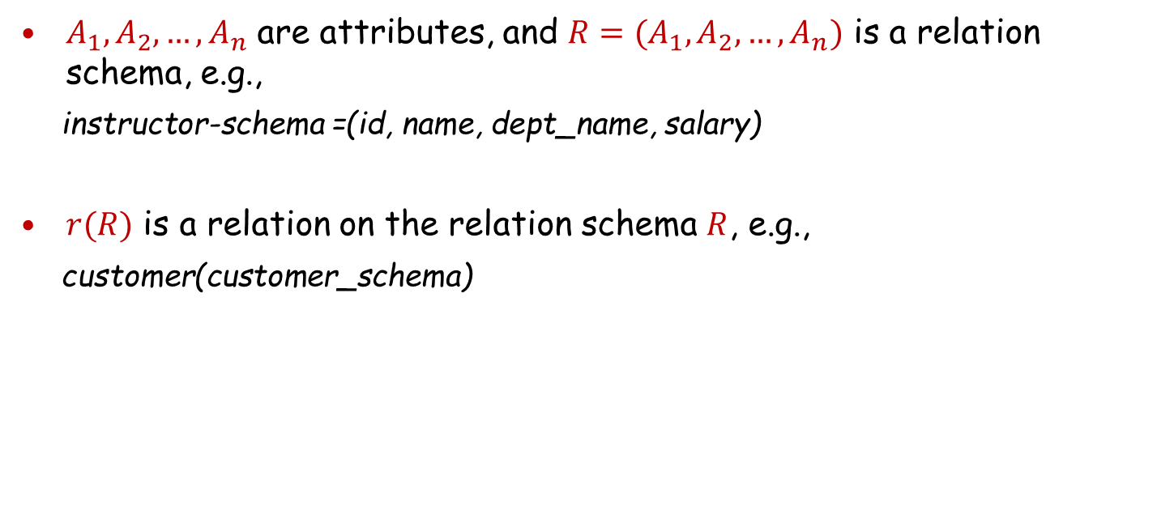
Relation Schema (关系模式)
$A_{1},A_{2},…,A_{n}$ are attributes, and $R=(A_{1},A_{2},…,A_{n})$ is a relation schema, e.g.,
instructor-schema =(id, name, dept_name, salary)
$r(R)$ is a relation on the relation schema $R$, e.g.,
customer(customer_schema)

Slide 8

Relation Instance (关系实例)
The current values (i.e., relation instance) of a relation are specified by a table
An element $t$ of relation $r$ is a tuple (元组), represented by a row in the table
Attributes/Columns
Tuples/Rows

Slide 9
Relations are Unordered
The order of tuples/attributes in a relation is irrelevant (无关紧要的). Tuples could be stored in an arbitrary order
E.g., instructor relation with unordered tuples

Slide 10
Outline
Structure of Relational Database
Database Schema
Keys
Schema Diagrams
Relational Query Languages
Relational Algebra

Slide 11
Database Schema
A database consists of multiple relations
Storing all information as a single relation results in
  repetition of information, e.g., one department has many students, record the information of both department and student
  the need for null values, e.g., represent a student with only a few courses
Normalization(规范化) theory (Chapter 7) discusses the ways to design relational schemas

Slide 12
E-R Diagram for University Database
Schema for University Database

Slide 13
Outline
Structure of Relational Database
Database Schema
Keys
Schema Diagrams
Relational Query Languages
Relational Algebra

Slide 14
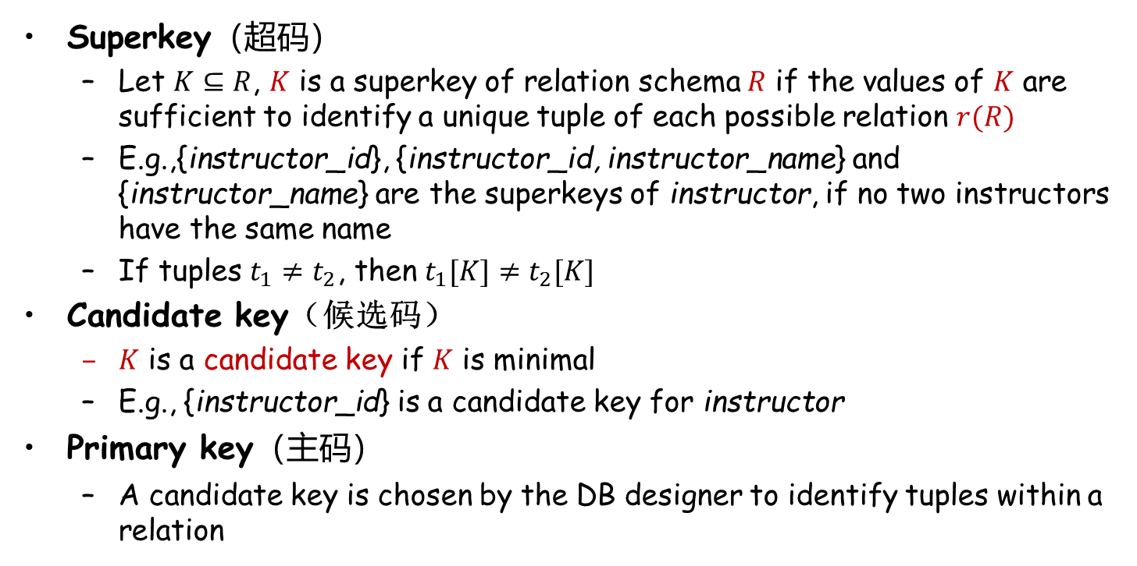
Keys (码、键)
Superkey（超码）
  Let $K⊆R$, $K$ is a superkey of relation schema $R$ if the values of $K$ are sufficient to identify a unique tuple of each possible relation $r(R)$
  E.g.,{instructor_id}, {instructor_id, instructor_name} and {instructor_name} are the superkeys of instructor, if no two instructors have the same name
  If tuples $t_{1}≠t_{2}$, then $t_{1}[K]≠t_{2}[K]$
Candidate key（候选码）
  $K$ is a candidate key if $K$ is minimal
  E.g., {instructor_id} is a candidate key for instructor
Primary key（主码）
  A candidate key is chosen by the DB designer to identify tuples within a relation

Slide 15
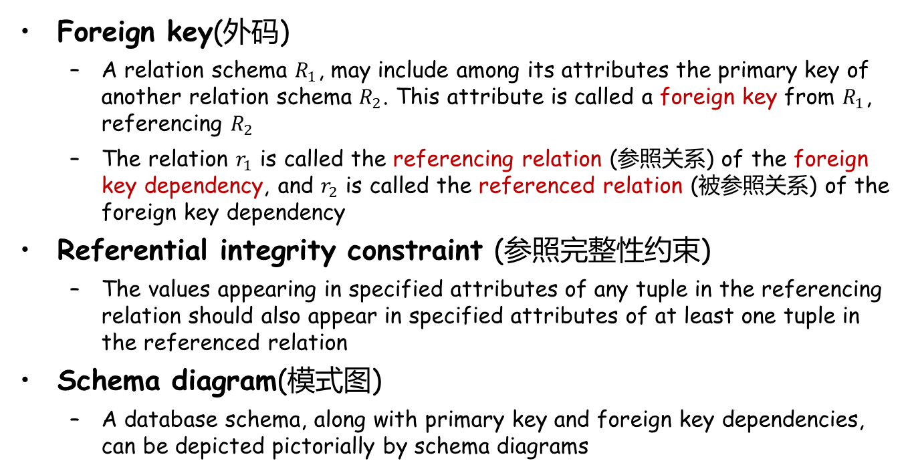
Keys (Cont.)
Foreign key(外码)
  A relation schema $R_{1}$, may include among its attributes the primary key of another relation schema $R_{2}$. This attribute is called a foreign key from $R_{1}$, referencing $R_{2}$
  The relation $r_{1}$ is called the referencing relation (参照关系) of the foreign key dependency, and $r_{2}$ is called the referenced relation (被参照关系) of the foreign key dependency
Referential integrity constraint (参照完整性约束)
  The values appearing in specified attributes of any tuple in the referencing relation should also appear in specified attributes of at least one tuple in the referenced relation
Schema diagram(模式图)
  A database schema, along with primary key and foreign key dependencies, can be depicted pictorially by schema diagrams

Slide 16
Outline
Structure of Relational Database
Database Schema
Keys
Schema Diagrams
Relational Query Languages
Relational Algebra

Slide 17
Schema Diagrams (模式图)
Schema diagram for the university database

Slide 18
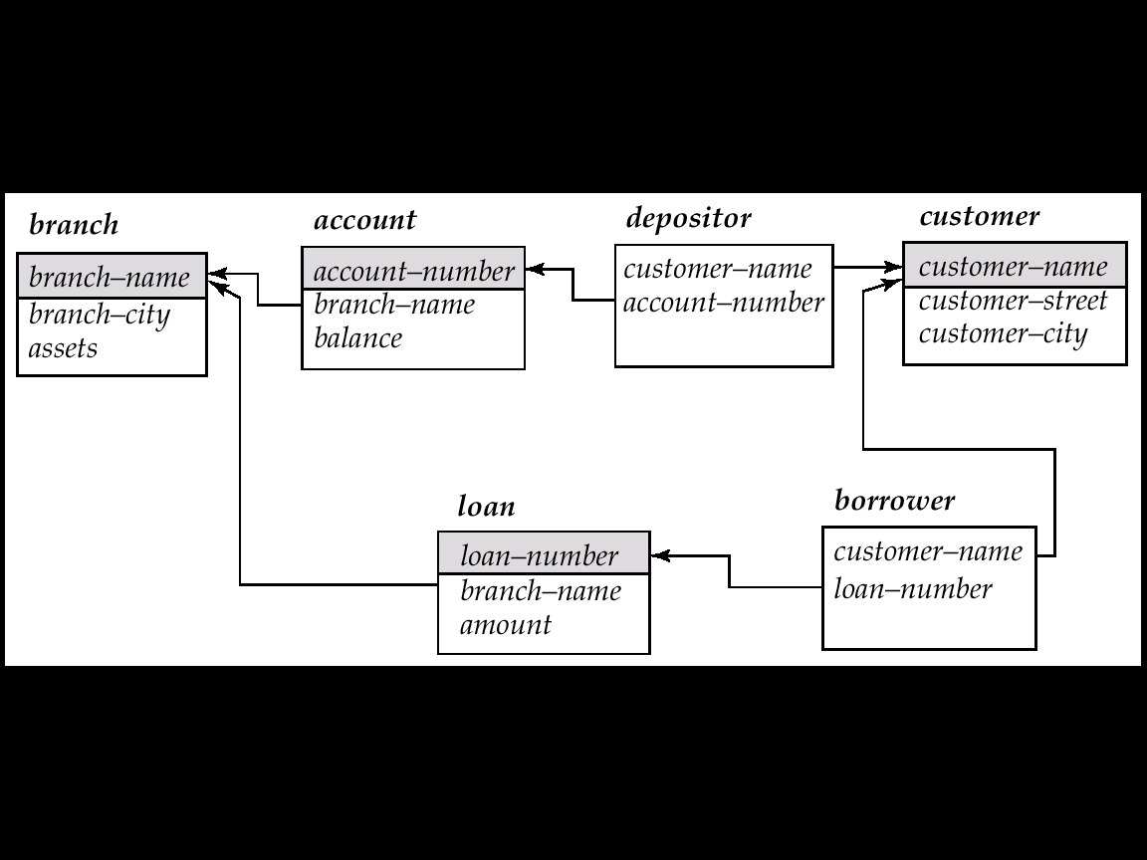
Schema Diagrams (模式图)
branch (branch_name, branch_city, assets)
customer (customer_name, customer_street, customer_city)
account (account_number, branch_name, balance)
loan (loan_number, branch_name, amount)
depositor (customer_name, account_number)
borrower (customer_name, loan_number)
Banking database
Schema Diagram for the banking database

Slide 19
Outline
Structure of Relational Database
Database Schema
Keys
Schema Diagrams
Relational Query Languages
Relational Algebra

Slide 20
Relational Query Languages
Languages used to request information from the database
Categories of query languages
  Procedural (过程式)
    Relational Algebra（关系代数）
  Non-procedural/Declarative （非过程式/声明式）
    SQL（结构化查询语言）
    Tuple Relational Calculus*（元组关系演算）
    Domain Relational Calculus*（域关系演算）

Slide 21
Outline
Structure of Relational Database
Database Schema
Keys
Schema Diagrams
Relational Query Languages
Relational Algebra

Slide 22
Relational Algebra (关系代数)
A procedural language consisting of a set of operations that take one or two relations as input and produce a new relation as the result
Six basic operations
  Select (选择)
  Project (投影)
  Union (集合并)
  Set difference (集合差)
  Cartesian product (笛卡尔积)
  Rename (重命名)

Slide 23



Select Operation (选择操作)
Notation: $σ_{P}\left(r\right)=\left\{t | t∈r and P\left(t\right)\right\}$
  $P$ is the selection predicate(选择谓词）consisting of $∧$(and), $∨$(or), ¬(not), $=$, $≠$, $<$, $>$, $≤$, $≥$
  E.g.,
A
B
C
D
A
B
C
D
α
α
β
β
α
β
β
β
1
5
12
23
7
7
3
10
α
β
α
β
1
23
7
10
relation $r$
$$σ_{A=B ∧ D>5}(r)$$

Slide 24
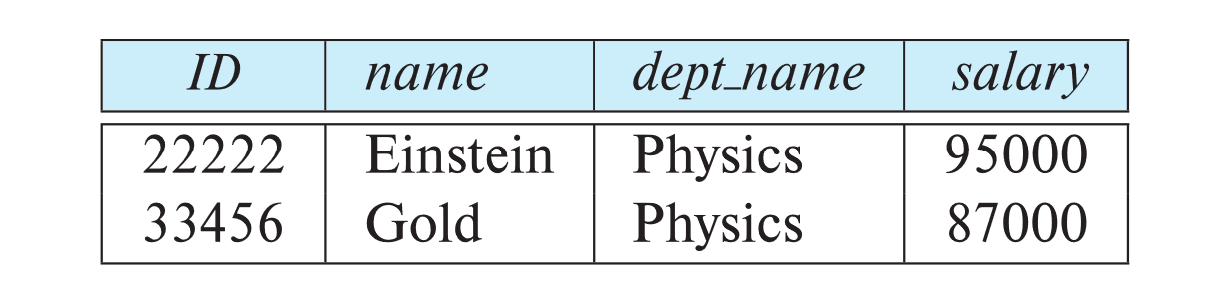
Select Operation (Cont.)
E.g., select those tuples of the instructor relation where the instructor is in the “Physics” department
  Query
  σ_{dept_name =“Physics”} (instructor)
  Result
Instructor relation

Slide 25
Select Operation (Cont.)
Can combine several predicates into a larger predicate by using the connectives: ∧ (and), ∨ (or), ¬ (not)
  E.g., find the instructors with a salary greater $90,000 in Physics Department
σ_{dept_name=“Physics”} ∧ _{salary >} _{90,000} (instructor)
The select predicate may include comparisons between two attributes.
  E.g., find all departments whose names are the same as their building names:
  σ _{dept_name=building} (department)

Slide 26

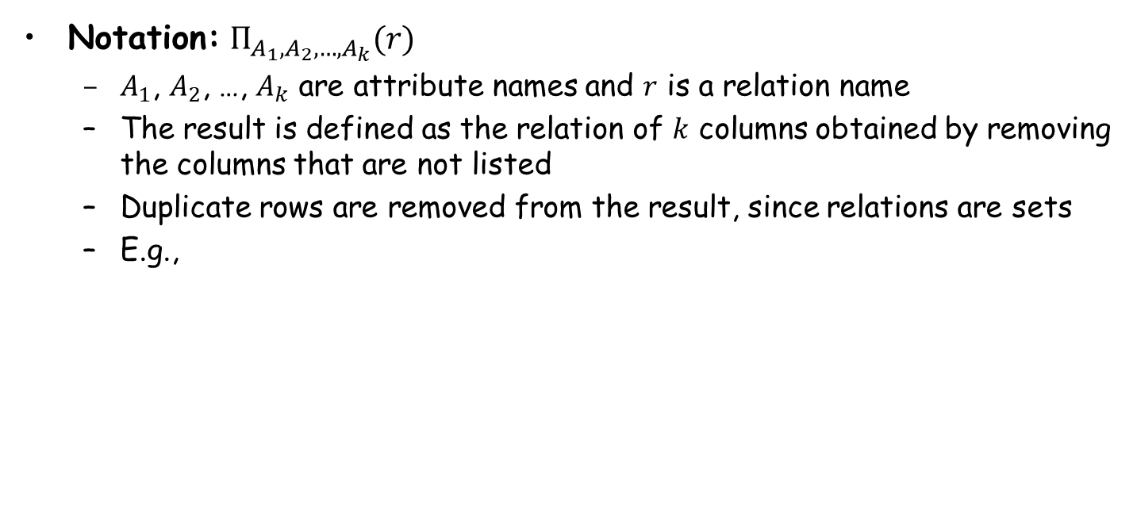

Project Operation (投影操作)
Notation: $Π_{A_{1},A_{2},…,A_{k}}(r)$
  $A_{1}$, $A_{2}$, …, $A_{k}$ are attribute names and $r$ is a relation name
  The result is defined as the relation of $k$ columns obtained by removing the columns that are not listed
  Duplicate rows are removed from the result, since relations are sets
  E.g.,
A
B
C
A
C
A
C
α
α
β
β
10
20
30
40
1
1
1
2
α
α
β
β
1
1
1
2
α
β
β
1
1
2
=
relation $r$
$$Π_{A,C}(r)$$

Slide 27
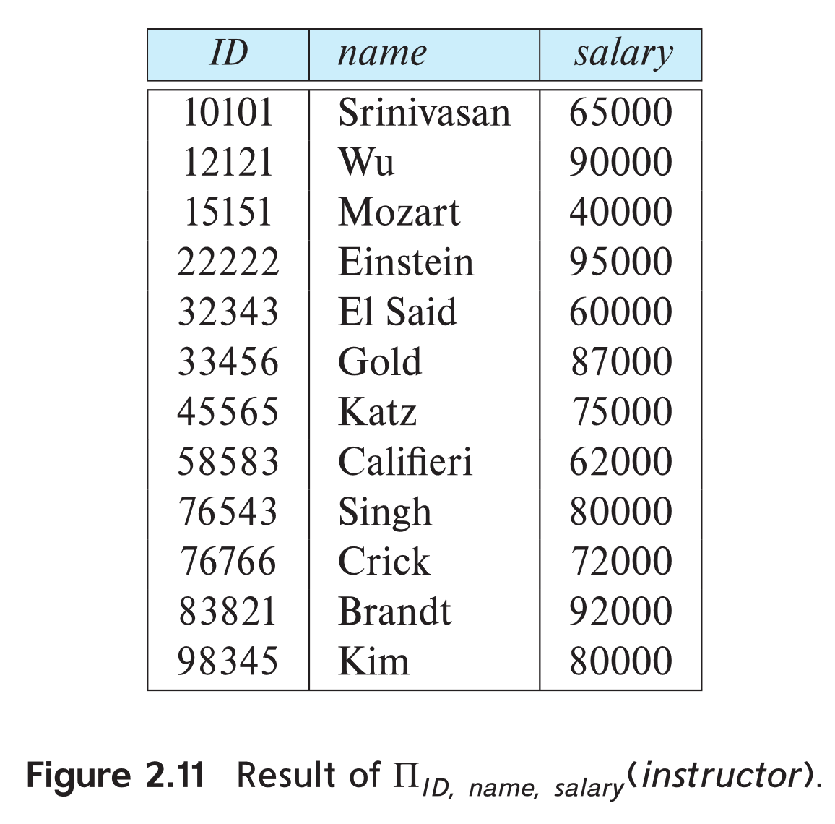
Project Operation (Cont.)
E.g., eliminate the dept_name attribute of instructor
Query:
∏_{ID, name, salary} (instructor)
Result:
Instructor relation

Slide 28

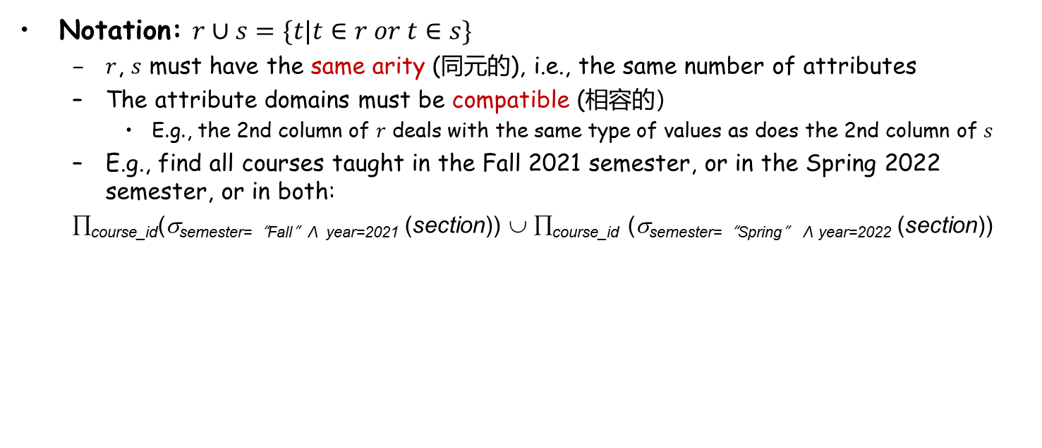

Set Union Operation (集合并操作)
Notation: $r∪s=\{t|t∈r or t∈s\}$
  $r$, $s$ must have the same arity (同元的), i.e., the same number of attributes
  The attribute domains must be compatible (相容的）
    E.g., the 2nd column of $r$ deals with the same type of values as does the 2nd column of $s$
  E.g., find all courses taught in the Fall 2021 semester, or in the Spring 2022 semester, or in both:
  ∏_{course_id}(σ_{semester=“Fall”Λ year=2021} (section)) ∪ ∏_{course_id} (σ_{semester=“Spring” Λ year=2022} (section))
A
B
A
B
A
B
α
α
β
1
2
1
α
β
2
3
α
α
β
β
1
2
1
3
s
r
relations $r$, $s$
$$r∪s$$

Slide 29



Set Difference Operation (集合差操作)
Notation: $r−s=\{t|t∈r and t∉s\}$
  Set difference must be taken between compatible relations, i.e., $r$ and $s$ must have the same arity and attribute domains
  E.g.,
A
B
A
B
A
B
α
α
β
1
2
1
α
β
2
3
α
β
1
1
s
r
relations $r$, $s$
$$r−s$$

Slide 30
Set Difference Operation (Cont.)
E.g., find all courses taught in the Fall 2021 semester, but not in the Spring 2022 semester
∏_{course_id}(σ_{semester=“Fall”Λ year=2021} (section)) − ∏_{course_id} (σ_{semester=“Spring”Λ year=2022} (section))

Slide 31

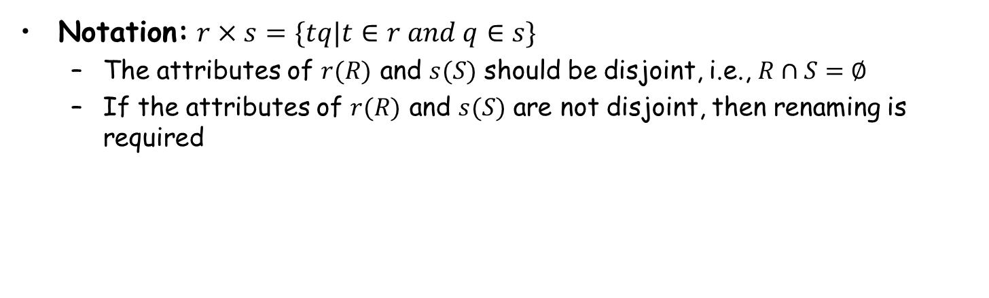

Cartesian Product Operation (笛卡尔积操作)
Notation: $r×s=\{tq|t∈r and q∈s\}$
  The attributes of $r(R)$ and $s(S)$ should be disjoint, i.e., $R∩S=∅$
  If the attributes of $r(R)$ and $s(S)$ are not disjoint, then renaming is required
A
B
C
D
E
A
B
C
D
E
α
α
α
α
β
β
β
β
1
1
1
1
2
2
2
2
α
β
β
γ
α
β
β
γ
10
10
20
10
10
10
20
10
a
a
b
b
a
a
b
b
α
β
1
2
α
β
β
γ
10
10
20
10
a
a
b
b
r
s
relations $r$, $s$
$$r×s$$

Slide 32
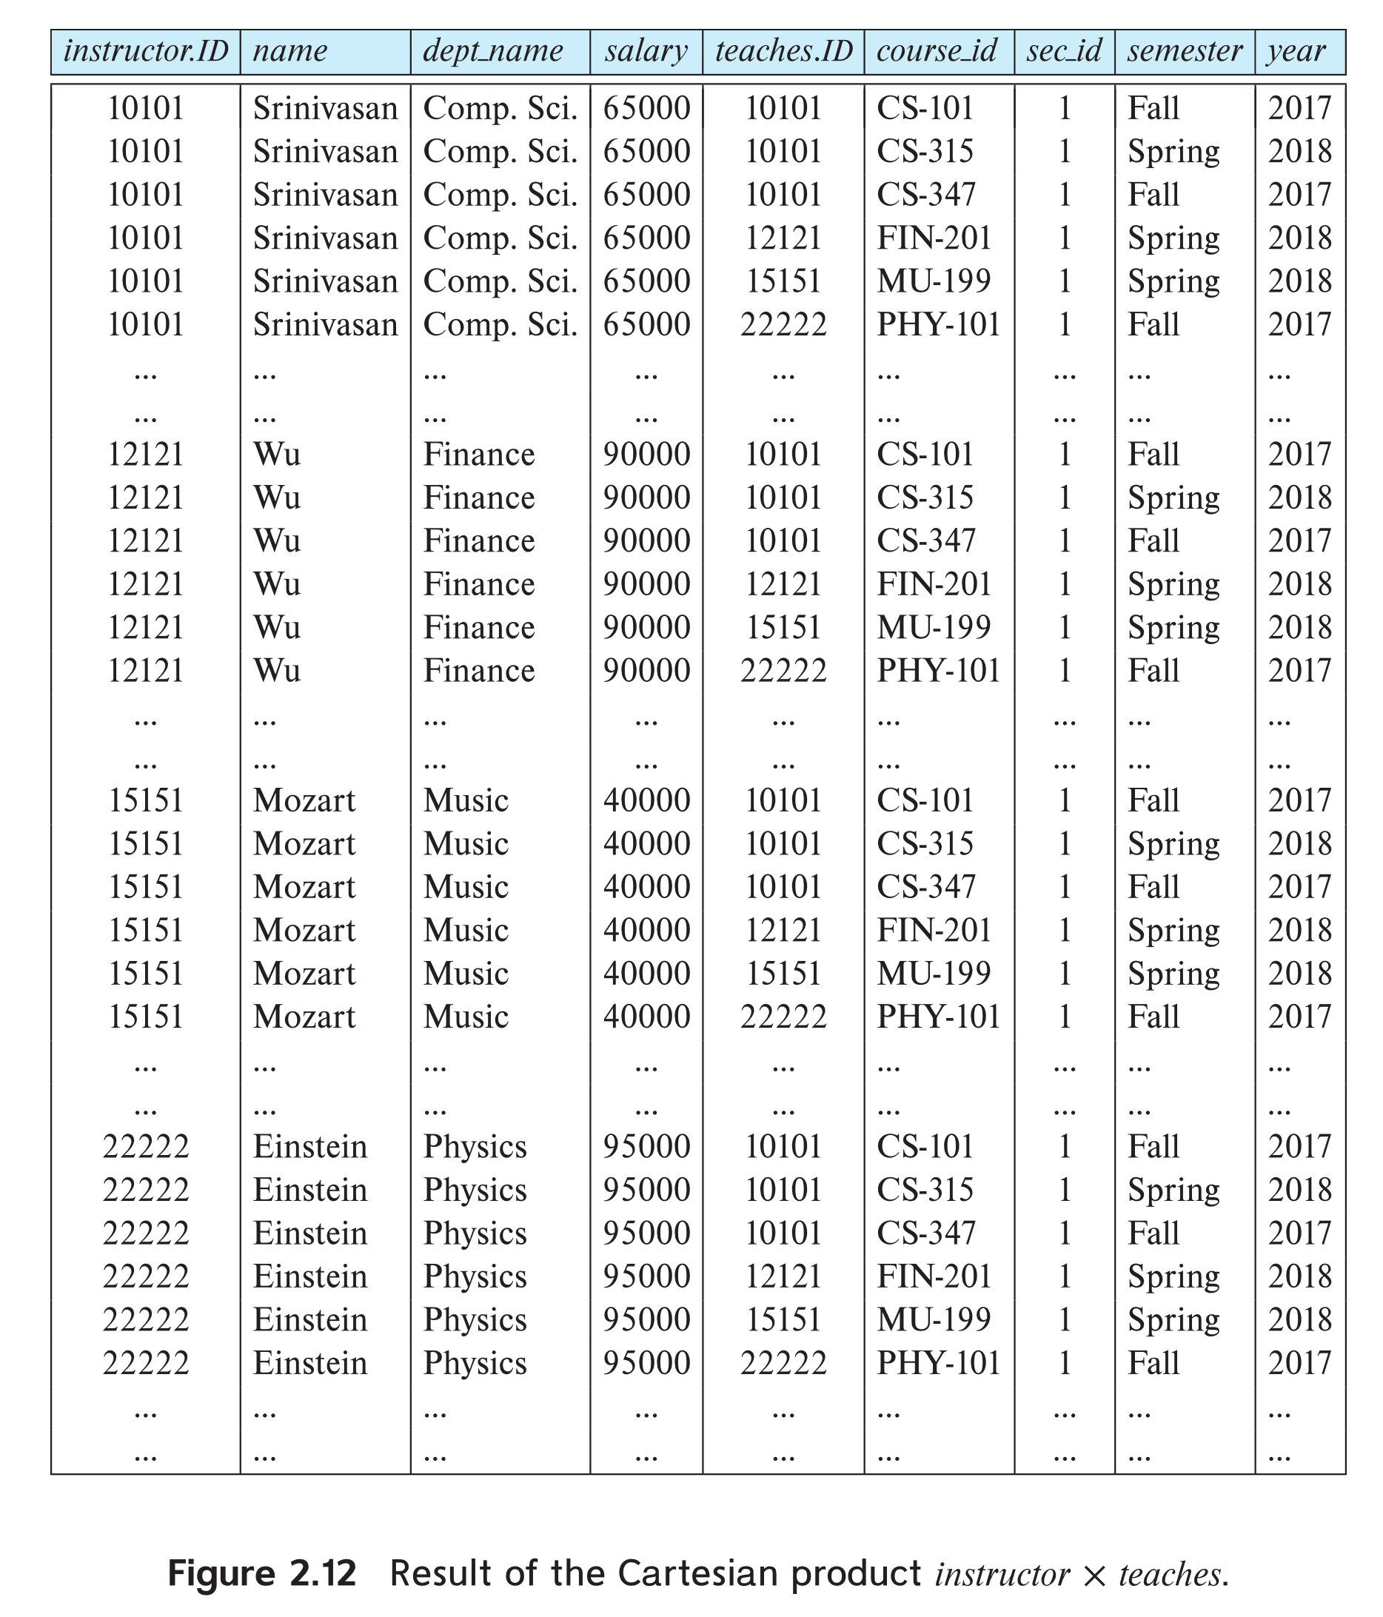
instructor X teaches

Slide 33
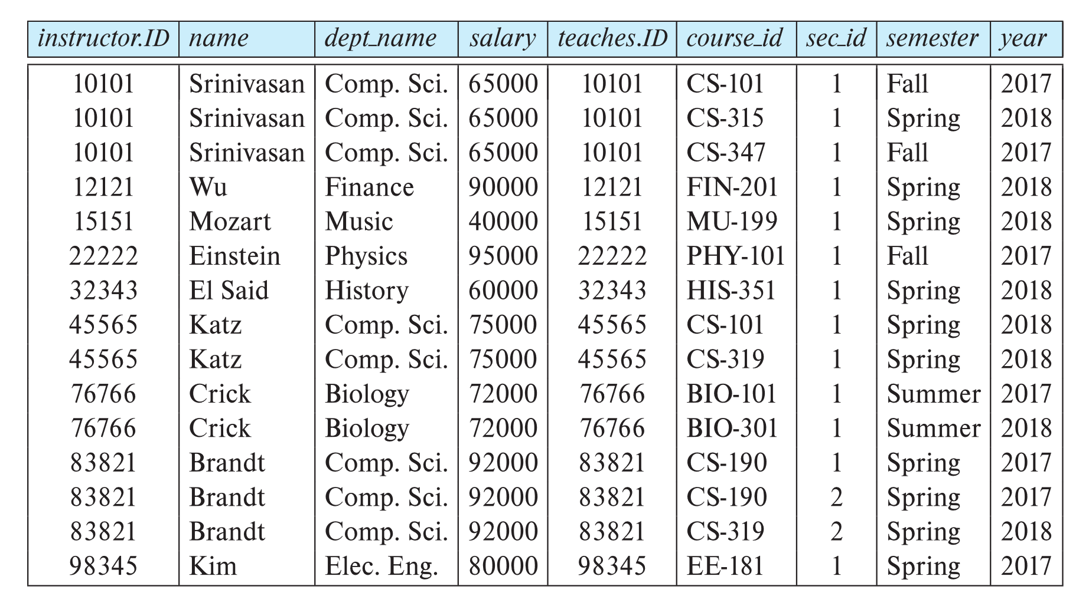
Cartesian Product Operation (Cont.)
σ_{instructor.id = teaches.id} (instructor x teaches))

Slide 34



Composition of Operations (组合操作)
Build expressions using multiple operations
  E.g., $σ_{A=C}(r×s)$
A
B
C
D
E
α
α
α
α
β
β
β
β
1
1
1
1
2
2
2
2
α
β
β
γ
α
β
β
γ
10
10
20
10
10
10
20
10
a
a
b
b
a
a
b
b
A
B
C
D
E
α
β
β
1
2
2
α
β
β
10
20
20
a
a
b
$$r×s$$
$$σ_{A=C}(r×s)$$

Slide 35
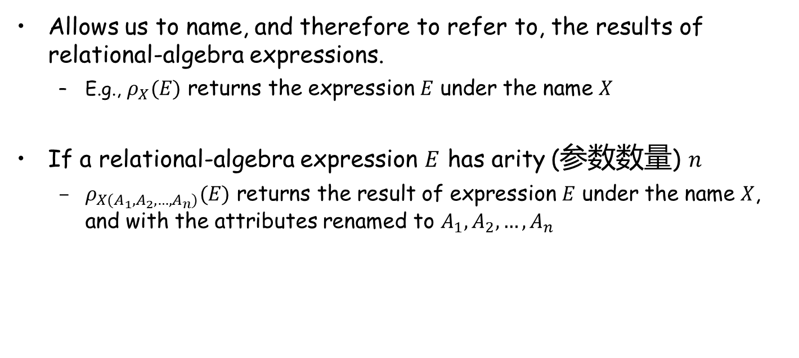
Rename Operation (更名运算)
Allows us to name, and therefore to refer to, the results of relational-algebra expressions.
  E.g., $ρ_{X}(E)$ returns the expression $E$ under the name $X$
If a relational-algebra expression $E$ has arity (参数数量) $n$
  $ρ_{X(A_{1}, A_{2}, …, A_{n})}(E)$ returns the result of expression $E$ under the name $X$, and with the attributes renamed to $A_{1}, A_{2},…,A_{n}$

Slide 36
Notes about Relational Languages
Each query input is a table (or a set of tables)
Each query output is a table.
All data in the output table appears in one of the input tables

Slide 37
Schema for Following Examples

Slide 38


Example 1
Find all loans of over $1200
Find the loan number for each loan of an amount greater than $1200
$$σ_{amount>1200}(loan)$$
$$Π_{loan_number}(σ_{amount>1200}(loan))$$

Slide 39
Example 2
Find the names of all customers who have a loan, an account, or both, from the bank
$$Π_{customer_name}\left(borrower\right){ ∪Π}_{customer_name}\left(depositor\right)$$

Slide 40
Example 3
Find the names of all customers who have a loan at the Jiading branch
Find the names of all customers who have a loan at the Jiading branch but do not have an account at any branch of the bank
∏_{customer_name} (σ_{branch_name=“Jiading”}
(σborrower.loan_number = loan.loan_number(borrower x loan)))
∏_{customer_name} (σ_{branch_name = “Jiading”}
(σborrower.loan_number = loan.loan_number(borrower x loan))) – ∏_{customer_name}(depositor)

Slide 41
Example 4
Find the names of all customers who have a loan at the Jiading branch
Query 1
Query 2
  ∏_{customer_name}(σ_{branch_name = “Jiading”} (
  σborrower.loan_number = loan.loan_number(borrower x loan)))
  ∏_{customer_name}(σloan.loan_number = borrower.loan_number
  ((σ_{branch_name = “Jiading”}(loan)) x borrower))

Slide 42
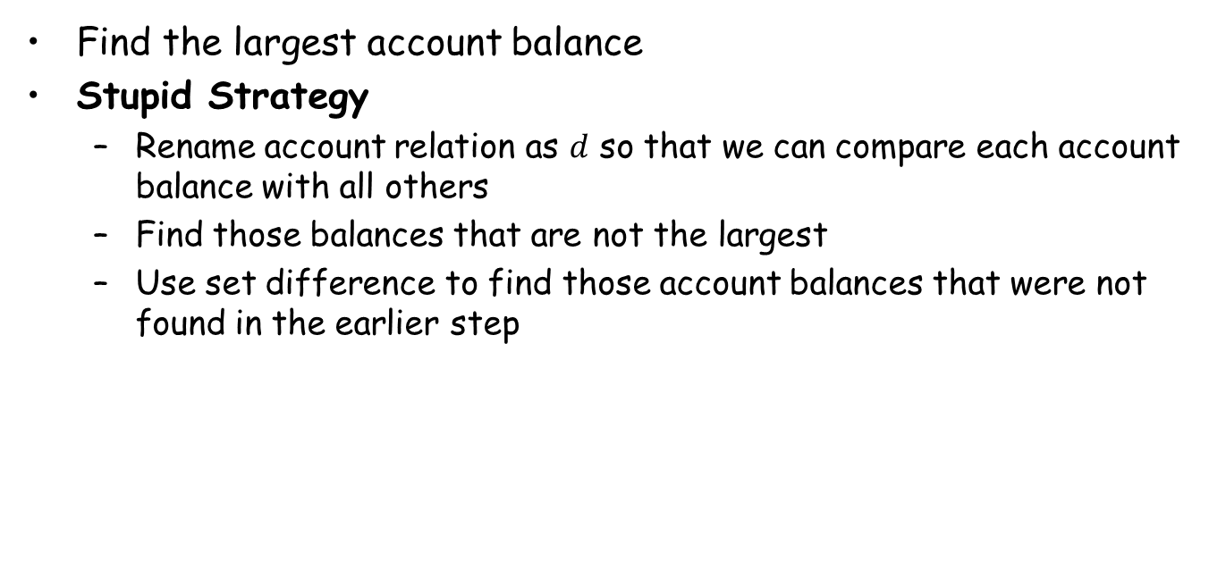
Example 5
Find the largest account balance
Stupid Strategy
  Rename account relation as $d$ so that we can compare each account balance with all others
  Find those balances that are not the largest
  Use set difference to find those account balances that were not found in the earlier step
∏_{balance}(account)
- ∏_{account.balance}
(σ_{account.balance < d.balance} (account x ρ_{d} (account)))

Slide 43
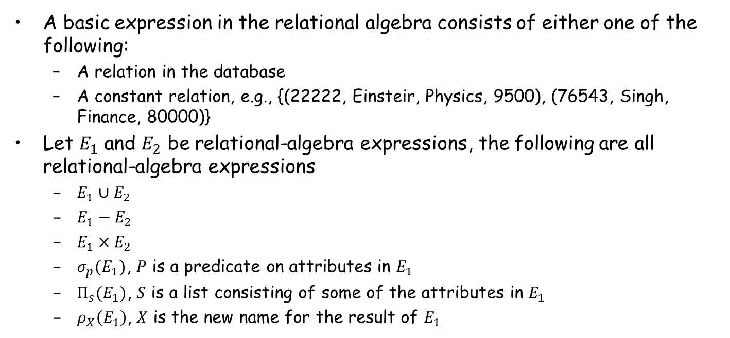
Relational Expressions (关系表达式)
A basic expression in the relational algebra consists of either one of the following:
  A relation in the database
  A constant relation, e.g., {(22222, Einsteir, Physics, 9500), (76543, Singh, Finance, 80000)}
Let $E_{1}$ and $E_{2}$ be relational-algebra expressions, the following are all relational-algebra expressions
  $E_{1}∪E_{2}$
  $E_{1}−E_{2}$
  $E_{1}×E_{2}$
  $σ_{p}(E_{1})$, $P$ is a predicate on attributes in $E_{1}$
  $Π_{s}(E_{1})$, $S$ is a list consisting of some of the attributes in $E_{1}$
  $ρ_{X}\left(E_{1}\right)$, $X$ is the new name for the result of $E_{1}$

Slide 44
Additional Operations
Additional operations
  Set intersection (集合交)
  Natural join (自然连接)
  Outer join（外连接）
  Division (除)
  Assignment (赋值)
Additional operations do not add any power to the relational algebra, but simplify the writing of queries

Slide 45






Set Intersection Operation (集合交操作)
Notation: $r∩s=\{t|t∈r and t∈s\}$
  $r$, $s$ have the same arity
  the attributes of $r$ and $s$ are compatible
  Note: $r∩s=r−(r−s)$
$$r$$
$$s$$
$$r−s$$
Relations $r$, $s$:
A B
A B
α
α
β
1
2
1
α
β
2
3
s
r
$r∩s$:
A B
α 2

Slide 46
Set Intersection Operation (Cont.)
E.g., find all courses taught in both the Fall 2021 and the Spring 2022 semesters.
∏_{course_id} (σ_{semester=“Fall” Λ year=2021} (section)) ∩ ∏_{course_id} (σ _{semester=“Spring” Λ year=2022} (section))

Slide 47
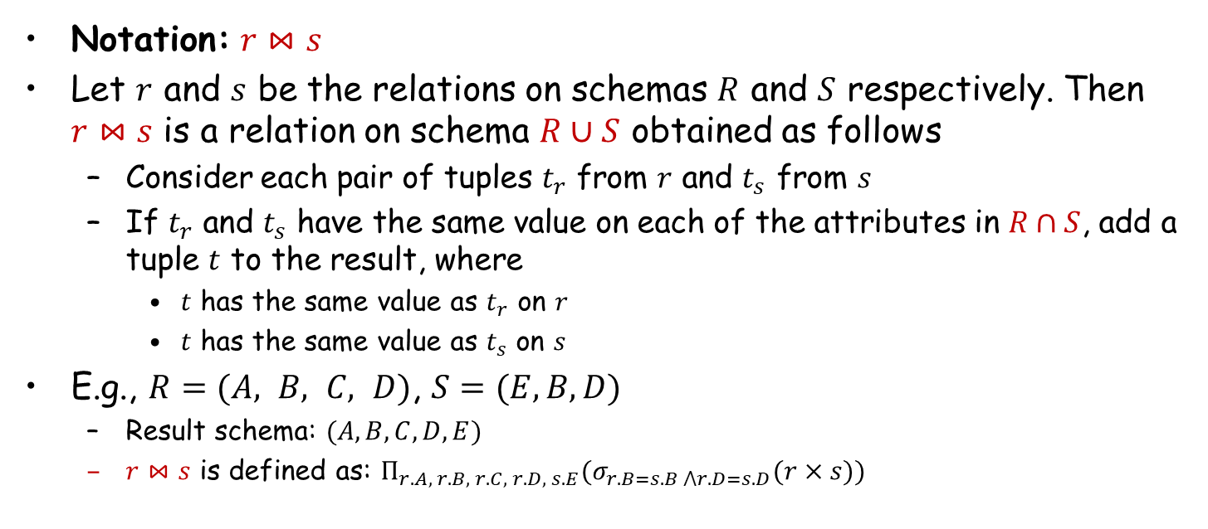
Natural Join Operation (自然连接操作)
Notation: $r⋈s$
Let $r$ and $s$ be the relations on schemas $R$ and $S$ respectively. Then $r⋈s$ is a relation on schema $R∪S$ obtained as follows
  Consider each pair of tuples $t_{r}$ from $r$ and $t_{s}$ from $s$
  If $t_{r}$ and $t_{s}$ have the same value on each of the attributes in $R∩S$, add a tuple $t$ to the result, where
    $t$ has the same value as $t_{r}$ on $r$
    $t$ has the same value as $t_{s}$ on $s$
E.g., $R=(A, B, C, D)$, $S=(E,B,D)$
  Result schema: $(A,B,C,D,E)$
  $r⋈s$ is defined as: $Π_{r.A, r.B, r.C, r.D, s.E}(σ_{r.B=s.B ⋀r.D=s.D}(r×s))$

Slide 48


Natural Join Operation – Example
A
B
C
D
B
D
E
α
β
γ
α
δ
1
2
4
1
2
α
γ
β
γ
β
a
a
b
a
b
1
3
1
2
3
a
a
a
b
b
α
β
γ
δ
∈
Relations $r$, $s$:
r
s
A
B
C
D
E
α
α
α
α
δ
1
1
1
1
2
α
α
γ
γ
β
a
a
a
a
b
α
γ
α
γ
δ
$r⋈s$:

Slide 49
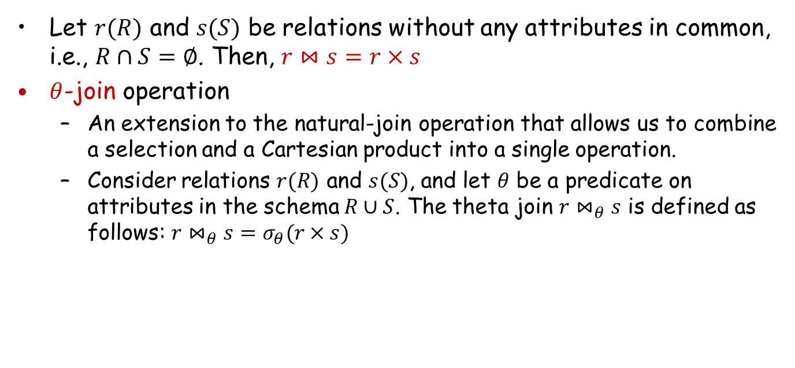
Natural Join Operation (Cont.)
Let $r(R)$ and $s(S)$ be relations without any attributes in common, i.e., $R∩S=∅$. Then, $r⋈s=r×s$
$θ$-join operation
  An extension to the natural-join operation that allows us to combine a selection and a Cartesian product into a single operation.
  Consider relations $r(R)$ and $s(S)$, and let $θ$ be a predicate on attributes in the schema $R∪S$. The theta join $r⋈_{θ}s$ is defined as follows: $r⋈_{θ}s=σ_{θ}(r×s)$

Slide 50




Join Operation – Example
r:
A B C
a1 b1 5
a1 b2 6
a2 b3 8
a2 b4 12
s:
B E
b1 3
b2 7
b3 10
b3 2
b5 2
Relations $r$, $s$:
A B C E
a1 b1 5 3
a1 b2 6 7
a2 b3 8 10
a2 b3 8 2
A R.B C S.B E
a1 b1 5 b1 3
a1 b2 6 b2 7
a2 b3 8 b3 10
a2 b3 8 b3 2
A R.B C S.B E
a1 b1 5 b2 7
a1 b1 5 b3 10
a1 b2 6 b2 7
a1 b2 6 b3 10
a2 b3 8 b3 10
$$r⋈s$$
$$r⋈_{r.B=s.B}s$$
$$r⋈_{C<E}s$$

Slide 51
Outer Join (外连接)
An extension of the join operation that avoids loss of information
Compute the join and then add tuples from one relation that does not match tuples in the other relation to the result of the join
Use null values:
  null signifies that the value is unknown or does not exist
  All comparisons involving null are (roughly speaking) false by definition

Slide 52
Outer Join – Example
loan-number
branch-name
amount
customer-name
loan-number
L-170
L-230
L-260
Downtown
Redwood
Perryridge
3000
4000
1700
Jones
Smith
Hayes
L-170
L-230
L-155
Relation loan
Relation borrower
loan-number
branch-name
amount
customer-name
loan-number
branch-name
amount
customer-name
L-170
L-230
Downtown
Redwood
3000
4000
Jones
Smith
L-170
L-230
L-260
Downtown
Redwood
Perryridge
3000
4000
1700
Jones
Smith
null
Inner Join: loan Borrower
Left Outer Join: loan Borrower
loan-number
branch-name
amount
customer-name
loan-number
branch-name
amount
customer-name
L-170
L-230
L-155
Downtown
Redwood
null
3000
4000
null
Jones
Smith
Hayes
L-170
L-230
L-260
L-155
Downtown
Redwood
Perryridge
null
3000
4000
1700
null
Jones
Smith
null
Hayes
Right Outer Join: loan borrower
Full Outer Join: loan borrower

Slide 53
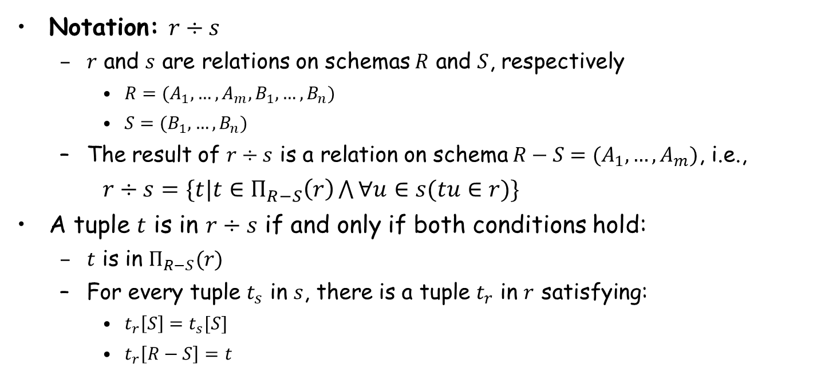
Division Operation (除操作)
Notation: $r÷s$
  $r$ and $s$ are relations on schemas $R$ and $S$, respectively
    $R=(A_{1},…,A_{m},B_{1},…,B_{n})$
    $S=(B_{1},…,B_{n})$
  The result of $r÷s$ is a relation on schema $R−S=(A_{1},…,A_{m})$, i.e.,
$r÷s=\{t|t∈Π_{R−S}\left(r\right)\bigwedge{∀u∈s(tu∈r)}\}$
A tuple $t$ is in $r÷s$ if and only if both conditions hold:
  $t$ is in $Π_{R−S}(r)$
  For every tuple $t_{s}$ in $s$, there is a tuple $t_{r}$ in $r$ satisfying:
    $t_{r}\left[S\right]=t_{s}[S]$
    $t_{r}\left[R−S\right]=t$

Slide 54
Division Operation – Example
Relations r, s :
A
B
B
r ÷ s :
A
α
α
α
β
γ
δ
δ
δ
∈
∈
β
1
2
3
1
1
1
3
4
6
1
2
1
2
α
β
s
r

Slide 55
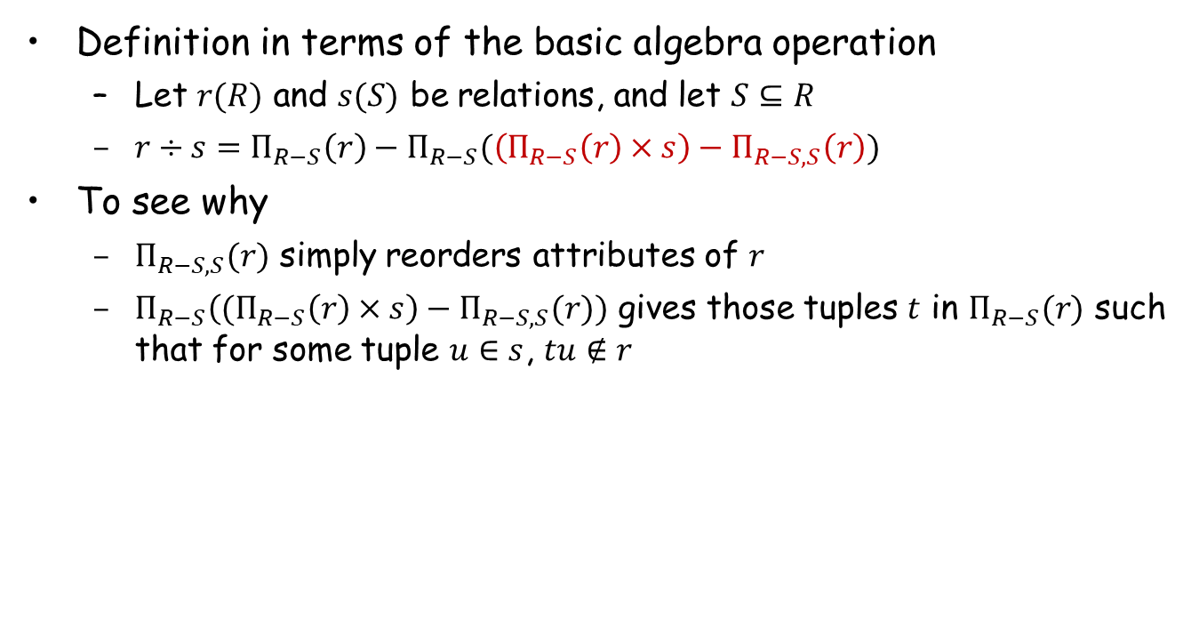
Division Operation (Cont.)
Definition in terms of the basic algebra operation
  Let $r(R)$ and $s(S)$ be relations, and let $S⊆R$
  $r÷s=Π_{R−S}\left(r\right)−Π_{R−S}(\left(Π_{R−S}\left(r\right)×s\right)−Π_{R−S,S}\left(r\right))$
To see why
  $Π_{R−S,S}(r)$ simply reorders attributes of $r$
  $Π_{R−S}\left((Π_{R−S}\left(r\right)×s\right)−Π_{R−S,S}(r))$ gives those tuples $t$ in $Π_{R−S}(r)$ such that for some tuple $u∈s$, $tu∉r$

Slide 56
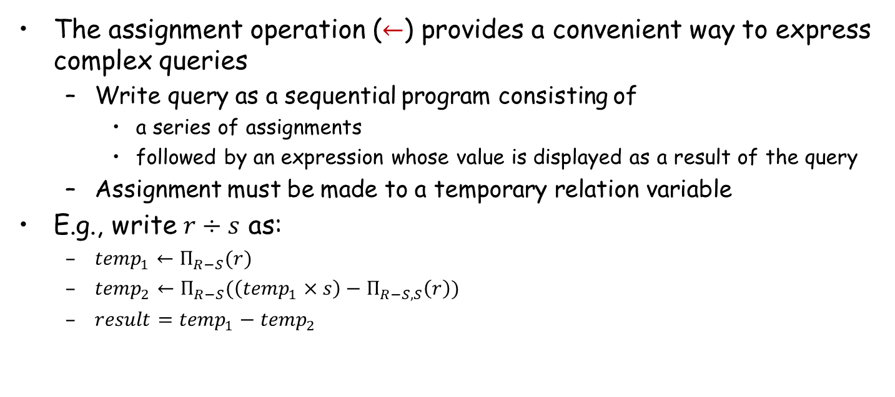
Assignment Operation
The assignment operation ($←$) provides a convenient way to express complex queries
  Write query as a sequential program consisting of
    a series of assignments
    followed by an expression whose value is displayed as a result of the query
  Assignment must be made to a temporary relation variable
E.g., write $r÷s$ as:
  ${temp}_{1}←Π_{R−S}(r)$
  ${temp}_{2}←Π_{R−S}(\left({temp}_{1}×s\right)−Π_{R−S,S}\left(r\right))$
  $result={temp}_{1}−{temp}_{2}$

Slide 57
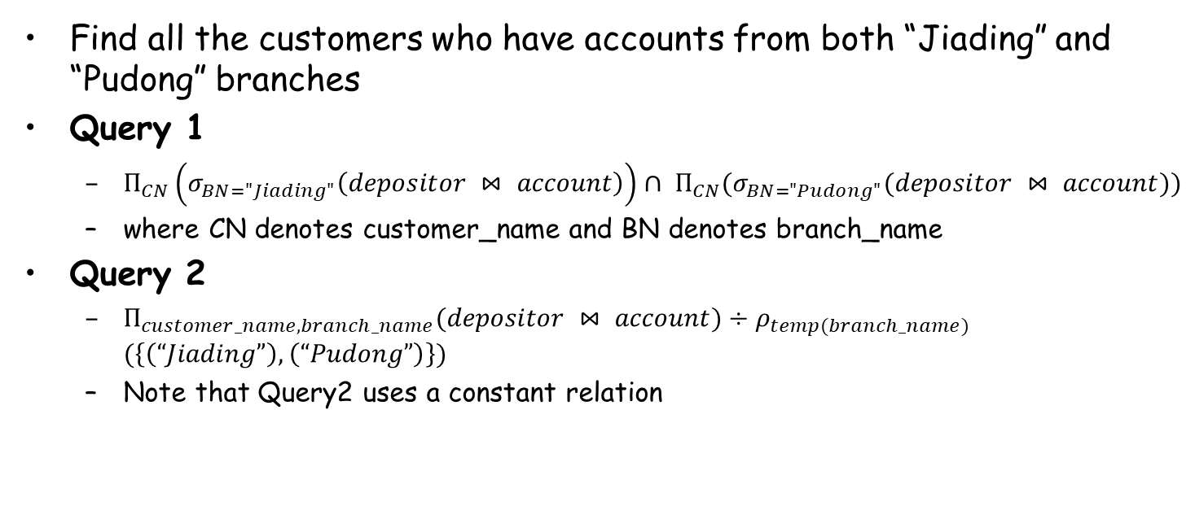
Example 6
Find all the customers who have accounts from both “Jiading” and “Pudong” branches
Query 1
  $Π_{CN}\left(σ_{BN="Jiading"}\left(depositor ⋈ account\right)\right)∩ Π_{CN}(σ_{BN="Pudong"}(depositor ⋈ account))$
  where CN denotes customer_name and BN denotes branch_name
Query 2
  $Π_{customer_name,branch_name}(depositor ⋈ account)÷ρ_{temp(branch_name)} (\left\{\left(“Jiading”\right), \left(“Pudong”\right)\right\})$
  Note that Query2 uses a constant relation

Slide 58

Example 7
Find all customers who have an account at all branches located in Shanghai
  $$Π_{customer_name,branch_name}\left(depositor ⋈ account\right)÷Π_{branch_name}(σ_{branch_city="Shanghai"}\left(branch\right))$$

Slide 59
Extended Relational Algebra Operations
Generalized Projection（广义投影）
Aggregate Functions （聚合函数）

Slide 60
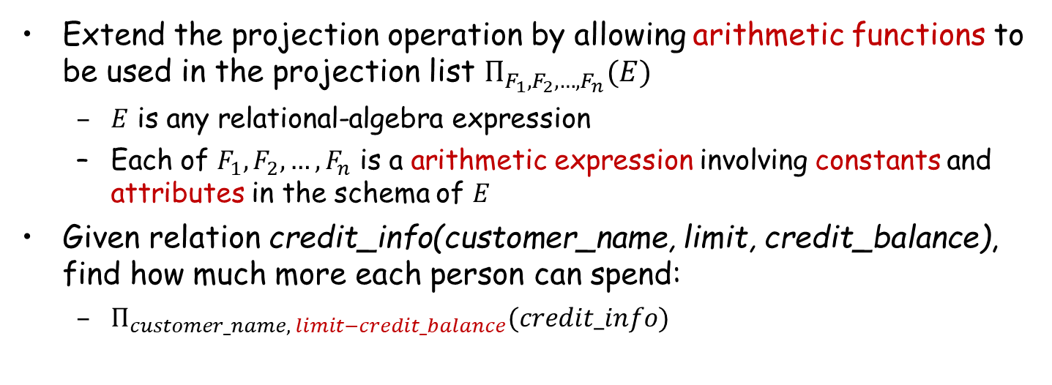
Generalized Projection
Extend the projection operation by allowing arithmetic functions to be used in the projection list $Π_{F_{1},F_{2},…,F_{n}}(E)$
  $E$ is any relational-algebra expression
  Each of $F_{1},F_{2},…,F_{n}$ is a arithmetic expression involving constants and attributes in the schema of $E$
Given relation credit_info(customer_name, limit, credit_balance), find how much more each person can spend:
  $Π_{customer_name, limit−credit_balance}(credit_info)$

Slide 61
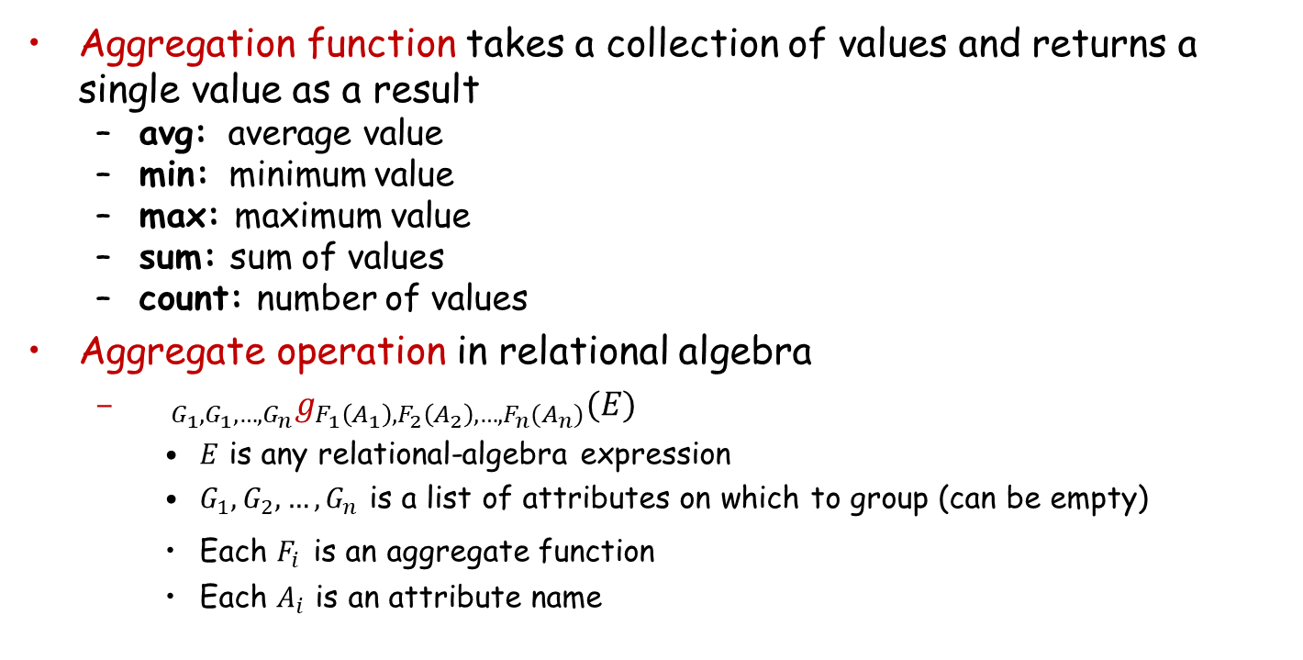
Aggregate Functions
Aggregation function takes a collection of values and returns a single value as a result
  avg: average value
  min: minimum value
  max: maximum value
  sum: sum of values
  count: number of values
Aggregate operation in relational algebra
  ${{}_{G_{1},G_{1},…,G_{n}}g}_{F_{1}\left(A_{1}\right),F_{2}\left(A_{2}\right),…,F_{n}(A_{n})}(E)$
    $E$ is any relational-algebra expression
    $G_{1},G_{2},…,G_{n}$ is a list of attributes on which to group (can be empty)
    Each $F_{i}$ is an aggregate function
    Each $A_{i}$ is an attribute name

Slide 62
Example
Relation r :
A
B
C
g _{sum(c)} (r) :
Sum(C)
α
α
β
β
α
β
β
β
7
7
3
10
27
Relation account grouped by branch_name:
_{branch_name} g _{sum(balance)} (account)
branch_name
account_number
balance
Perryridge
Perryridge
Brighton
Brighton
Redwood
A-102
A-201
A-217
A-215
A-222
400
900
750
750
700
branch_name
balance
Perryridge
Brighton
Redwood
1300
1500
700

Slide 63
Aggregate Functions (Cont.)
The result of aggregation does not have a name
  Can use rename operation to give it a name
  For convenience, we permit renaming as part of aggregate operation
_{branch_name} g _{sum(balance) as sum_balance} (account)

Slide 64
Null Values
It is possible for tuples to have a null value for some of their attributes
  null signifies an unknown value or that a value does not exist
The result of any arithmetic expression involving null is null
Aggregate functions simply ignore null values
  Is an arbitrary decision? Could have returned null as result instead?
  We follow the semantics of SQL in its handling of null values
For duplicate elimination and grouping, null is treated like any other value, and two nulls are assumed to be the same
  Alternative: assume each null is different from each other
  Both are arbitrary decisions, so we simply follow SQL

Slide 65
Null Values
Three-valued logic (三值逻辑) using the truth value unknown
  OR: (unknown or true) = true,
  (unknown or false) = unknown
  (unknown or unknown) = unknown
  AND: (true and unknown) = unknown,
  (false and unknown) = false,
  (unknown and unknown) = unknown
  NOT: (not unknown) = unknown
  In SQL, “P is unknown” evaluates to true if predicate P evaluates to unknown
Result of select predicate is treated as false if it evaluates to unknown

Slide 66
Modification of the Database
The content of the database may be modified by using the following operations:
  Deletion (删除)
  Insertion (插入)
  Updating (更新)
All these operations are expressed using the assignment operation

Slide 67
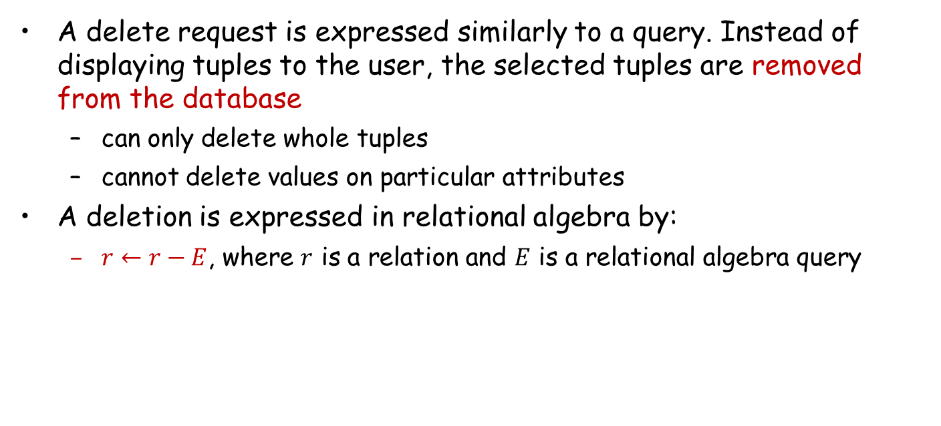
Deletion
A delete request is expressed similarly to a query. Instead of displaying tuples to the user, the selected tuples are removed from the database
  can only delete whole tuples
  cannot delete values on particular attributes
A deletion is expressed in relational algebra by:
  $r←r−E$, where $r$ is a relation and $E$ is a relational algebra query

Slide 68
Deletion Examples
Delete all account records in the Jiading branch.
Delete all loan records with amount in the range of 0 to 50
Delete all accounts at branches located in Shanghai
account ← account – σ _{branch_name = “Jiading”} (account)
loan ← loan – σ _{amount ≥ 0 and amount ≤ 50} (loan)
r₁ ← σ _{branch_city = “Shanghai”} (account branch)
r₂ ← ∏branch_name, account_number, balance (r₁)
r₃ ← ∏ _{customer_name, account_number} (r₂ depositor)
account ← account – r₂
depositor ← depositor – r₃

Slide 69
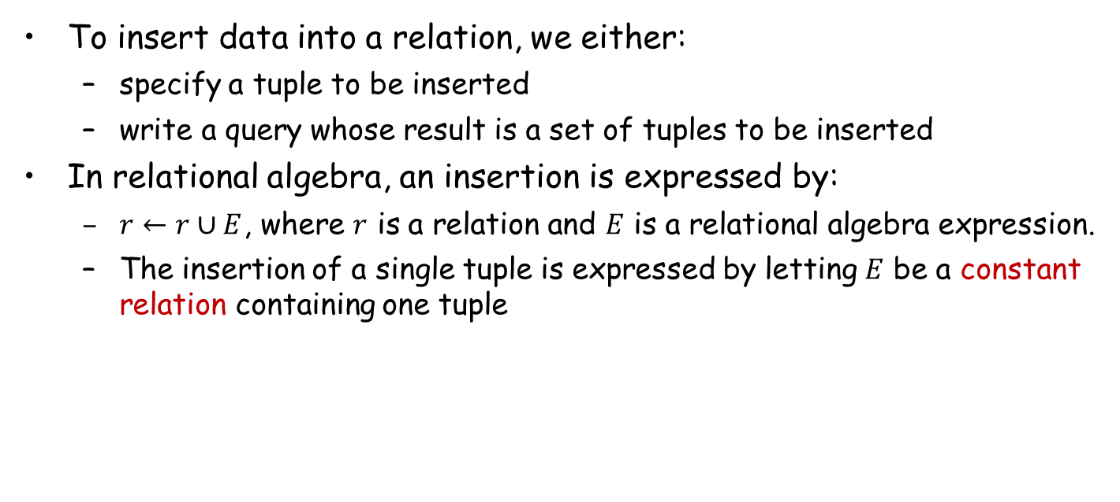
Insertion
To insert data into a relation, we either:
  specify a tuple to be inserted
  write a query whose result is a set of tuples to be inserted
In relational algebra, an insertion is expressed by:
  $r←r∪E$, where $r$ is a relation and $E$ is a relational algebra expression.
  The insertion of a single tuple is expressed by letting $E$ be a constant relation containing one tuple

Slide 70
Insertion Examples
Insert information in the database specifying that Smith has $1200 in account A_973 at the Jiading branch.
Provide as a gift for all loan customers in the Jiading branch, a $200 savings account. Let the loan number serve as the account number for the new savings account.
account ← account ∪ {(A_973, “Jiading”, 1200)}
depositor ← depositor ∪ {(“Smith”, A_973)}
r₁ ← (σ_{branch_name = “Jiading”} (borrower loan))
account ← account ∪ ∏_{loan_number, branch_name, 200} (r₁)
depositor ← depositor ∪ ∏_{customer_name, loan_number}(r₁)

Slide 71
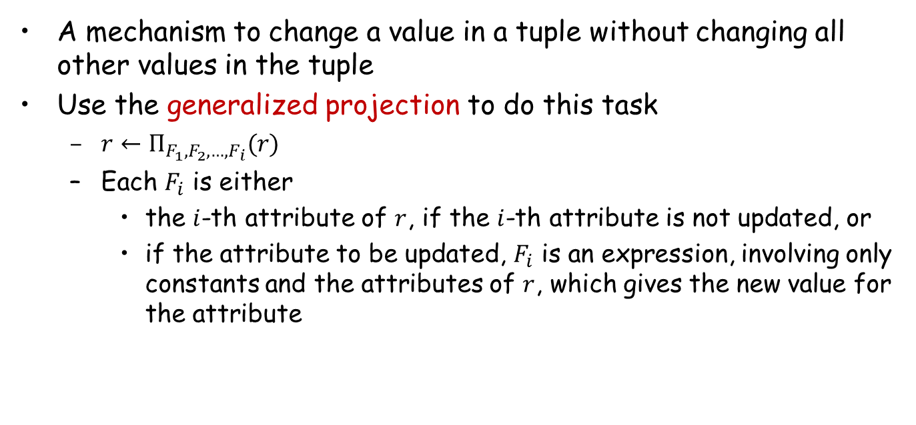
Updating
A mechanism to change a value in a tuple without changing all other values in the tuple
Use the generalized projection to do this task
  $r←Π_{F_{1},F_{2},…,F_{i}}(r)$
  Each $F_{i}$ is either
    the $i$-th attribute of $r$, if the $i$-th attribute is not updated, or
    if the attribute to be updated, $F_{i}$ is an expression, involving only constants and the attributes of $r$, which gives the new value for the attribute

Slide 72
Update Examples
Make interest payments by increasing all balances by 5%
  where AN, BN and BAL stand for account_number, branch_name and balance, respectively
Pay all accounts with balances over $10,000 6% interest and pay all others 5%
account ← ∏ _{AN, BN, BAL * 1.05} (account)
account ← ∏ _{AN, BN, BAL * 1.06} (σ _{BAL > 10000} (account))
∪ ∏_{AN, BN, BAL * 1.05} (σ_{BAL ≤ 10000} (account))

Slide 73
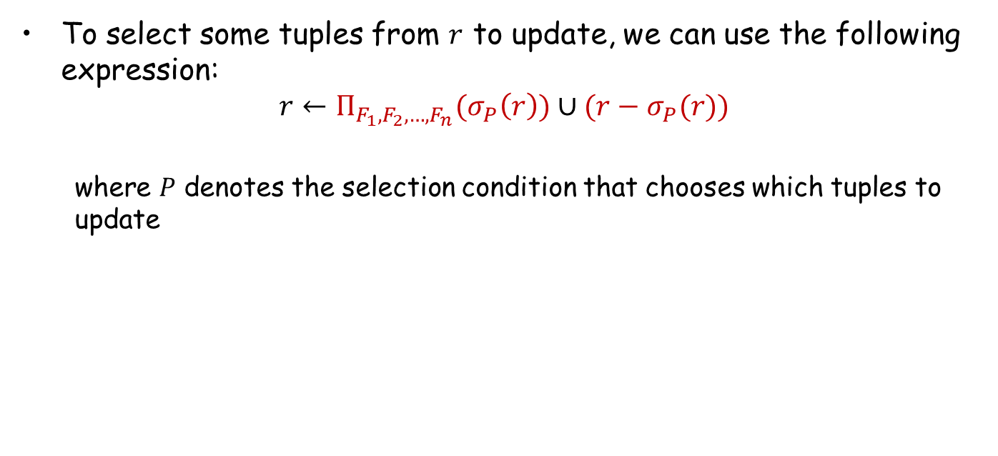
Updating
To select some tuples from $r$ to update, we can use the following expression:
$$r←Π_{F_{1},F_{2},…,F_{n}}(σ_{P}\left(r\right))∪(r−σ_{P}(r))$$
  where $P$ denotes the selection condition that chooses which tuples to update

Slide 74
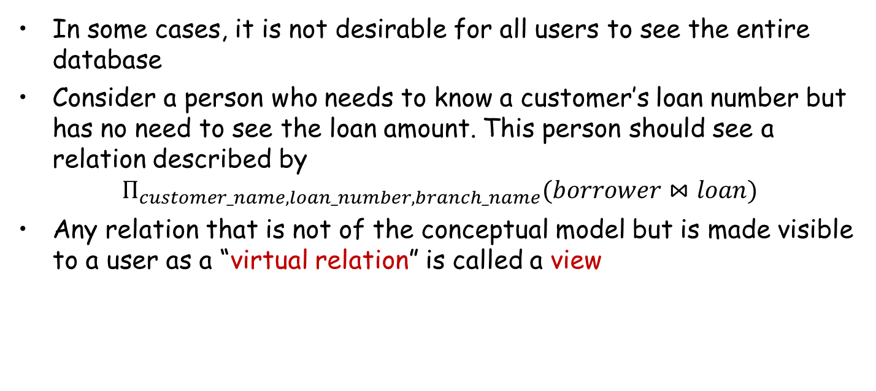
Views（视图）
In some cases, it is not desirable for all users to see the entire database
Consider a person who needs to know a customer’s loan number but has no need to see the loan amount. This person should see a relation described by
$$Π_{customer_name, loan_number, branch_name}(borrower⋈loan)$$
Any relation that is not of the conceptual model but is made visible to a user as a “virtual relation” is called a view

Slide 75
View Definition
A view is defined using the create view statement which has the follow form
create view v as < query expression >
Once a view is defined, the view name can be used to refer to the virtual relation that the view generates
View definition is not the same as creating a new relation by evaluating the query expression
  a view definition causes the saving of an expression
  the expression is substituted into queries using the view

Slide 76
Examples
Consider the view (all_customer) consisting of branches and their customers
We can find all customers of the Jiading branch by writing:
create view all_customer as
∏_{branch_name, customer_name} (depositor account)
∪ ∏_{branch_name, customer_name} (borrower loan)
∏_{customer_name} (σ_{branch_name = “Jiading”} (all_customer))

Slide 77
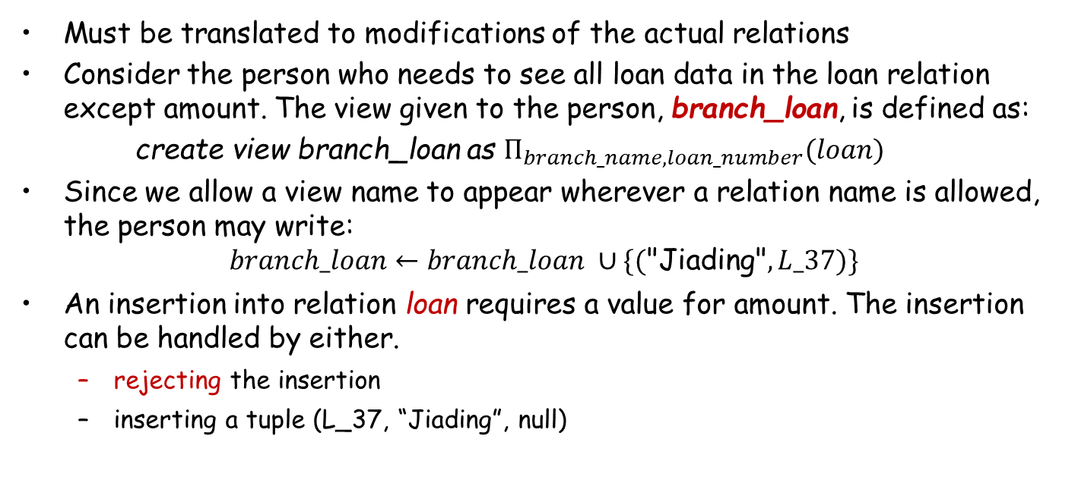
Updates Through View
Must be translated to modifications of the actual relations
Consider the person who needs to see all loan data in the loan relation except amount. The view given to the person, branch_loan, is defined as:
create view branch_loan as $Π_{branch_name,loan_number}(loan)$
Since we allow a view name to appear wherever a relation name is allowed, the person may write:
$$branch_loan←branch_loan ∪\{(\text{"}\text{Jiading}\text{"}, L_37)\}$$
An insertion into relation loan requires a value for amount. The insertion can be handled by either.
  rejecting the insertion
  inserting a tuple (L_37, “Jiading”, null)

Slide 78
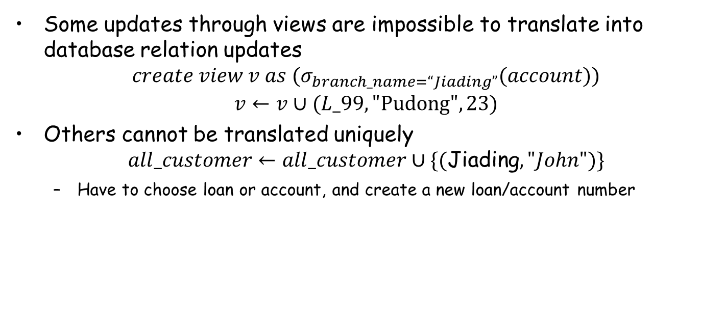
Updates Through Views (Cont.)
Some updates through views are impossible to translate into database relation updates
$$create view v as (σ_{branch_name=“Jiading”}(account))$$
$$v←v∪(L_99,\text{"}\text{Pudong}\text{"},23)$$
Others cannot be translated uniquely
$$all_customer←all_customer∪\{(\text{Jiading},"John")\}$$
  Have to choose loan or account, and create a new loan/account number

Slide 79
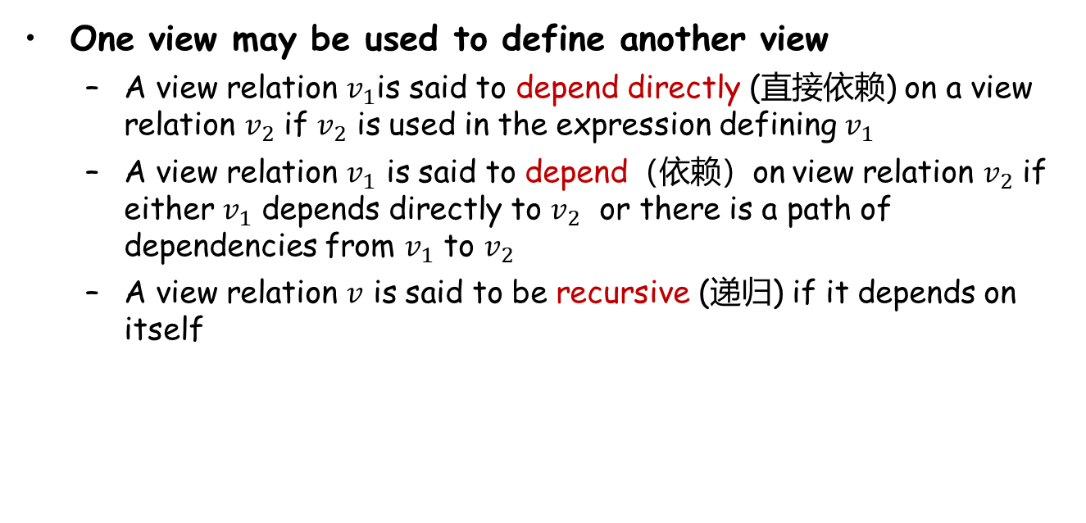
Views Defined Using Other Views
One view may be used to define another view
  A view relation $v_{1}$is said to depend directly (直接依赖) on a view relation $v_{2}$ if $v_{2}$ is used in the expression defining $v_{1}$
  A view relation $v_{1}$ is said to depend（依赖）on view relation $v_{2}$ if either $v_{1}$ depends directly to $v_{2}$ or there is a path of dependencies from $v_{1}$ to $v_{2}$
  A view relation $v$ is said to be recursive (递归) if it depends on itself

Slide 80
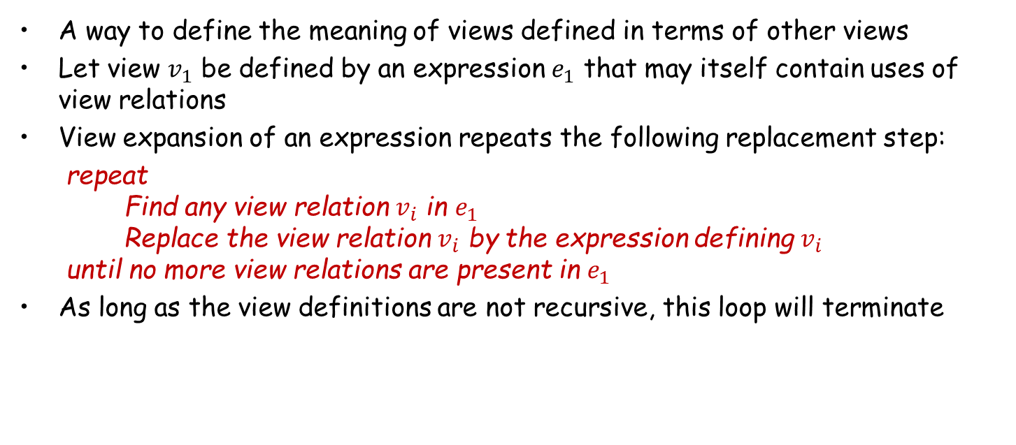
View Expansion
A way to define the meaning of views defined in terms of other views
Let view $v_{1}$ be defined by an expression $e_{1}$ that may itself contain uses of view relations
View expansion of an expression repeats the following replacement step:
repeat
Find any view relation $v_{i}$ in $e_{1}$
Replace the view relation $v_{i}$ by the expression defining $v_{i}$
until no more view relations are present in $e_{1}$
As long as the view definitions are not recursive, this loop will terminate

Slide 81
Homework
Exercises
  2.1, 2.6, 2.7, 2.8, 2.15 （选择其中3个）
Submission
  Canvas上提交，上传单个PDF文件

Slide 82
End of Chapter 2

